Slide 1
Explainable Task Failure Prediction in Cloud Datacenter Using Machine Learning
Team - 03
Name: Afsana Kabir Sinthia
Id: 23166004
Name: Nisat Islam Mozumder
Id: 22366047
Name : Md. Tariqul Islam
Id: 23173006
Name : Sadia Islam
Id: 23166021
Name: Iffat Ara Jui Id: 23166010

Slide 2
Introduction
Shared clusters: ideal for hosting applications due to scalability needs.
Resource allocation by central manager; app-specific logic by app managers.
Cloud system deployment presents challenges and opportunities.
Solutions for co-located workloads enhance resource optimization.
Challenges in managing persistent services within shared clusters.
Model validated through Alibaba cluster traces analysis.
Proposed failure prediction model bolsters cloud service dependability.
Study delves into task failure prediction, building upon prior insights.
Aspires to contribute to a more dependable cloud data center environment.
To analyzes several cloud traces to determine the relationship between job/task failure and cloud trace attributes.Develop and execute a failure prediction model combining several machine learning techniques with cloud workload traces.

Slide 3
Literature Review( 15 paper)
To improve the forecast accuracy an ensembled forecasting module is made which includes VMD technique to decrease the randomness of workload sequences, a Local-RNN, an R-Transformer to obtain nonlinear information of the time series for very high workload forecast accuracy.
To predict failing tasks and jobs in cloud data centers researcher applied several ML and deep failure prediction model like multi-layer BiLSTM for regression, random forest, XGBoost or SVM or an adaboost ensembled classifier or ANN-CNN method ensemble with ILP for heuristic optimization to reduce failure prediction.
An unique research works on real-time streaming data in accordance with the order of job arrival which is based on online sequential extreme learning machine that forecasts online job termination status.
A popular model consists of a cloud infrastructure management unit and an ML-based fault prediction unit where both the container-based and VM-based cloud architecture are managed by a orchestrator.

Slide 4
Background and Problem
-Cloud management system generally faces different types of cloud failures. - When the system works on the implementation and deployment; failure occurs most of the time. - Failure in the cloud generally occurs when a system cannot perform its modeled function because of hardware dysfunction or a sudden halt of the software. - There are two types of failures that are common in cloud computing. They are: (a) Structural Failures and (b) Situational Failures. - Structural failures include performance and resource failures and situational failures include dependent failures and independent failures. - To solve these problems task failure management is needed. - In this management, there are some categories of fault management such as: stop redundancy, fault prediction, and load balancing. -In this paper, we have tried to establish a model that can predict failure using machine learning algorithms. Here we have used KNN, Xgboost, Random Forest, and SVM algorithms for training our dataset.

Slide 5
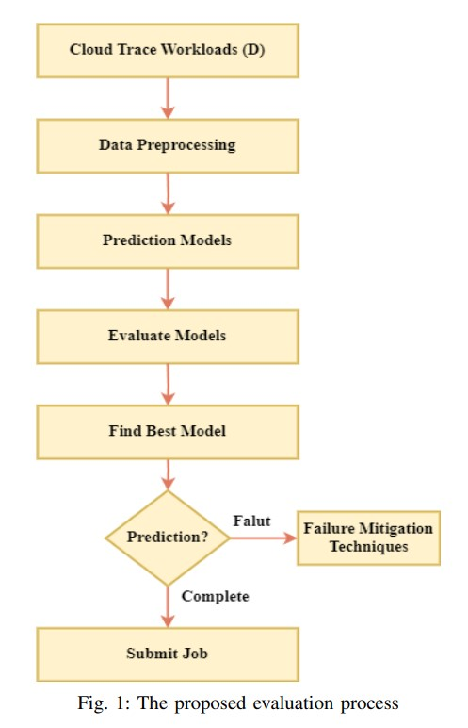
Methodology

Slide 6
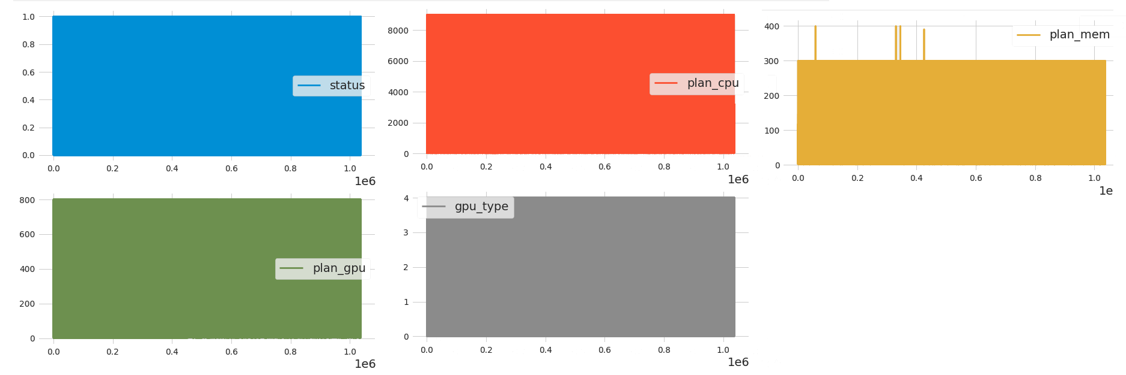
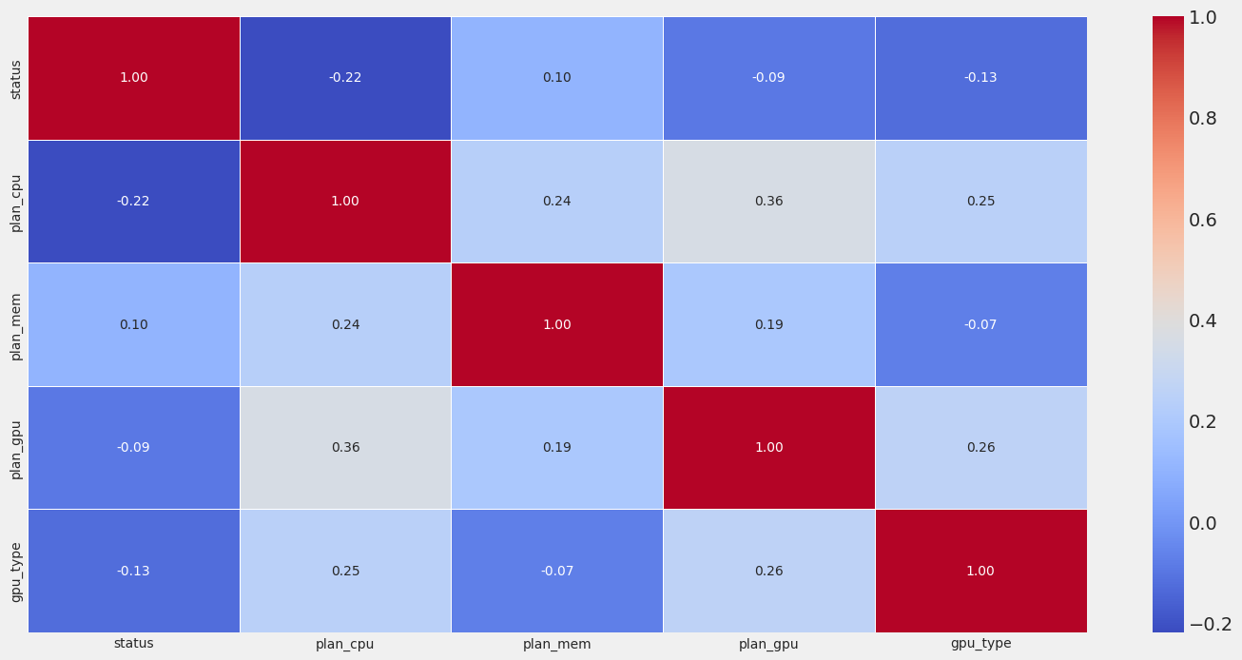
Dataset Analysis
Fig. 2: Analysis of Alibaba cloud trace dataset
Fig:3 Heatmap visualization of the correlation matrix

Slide 7
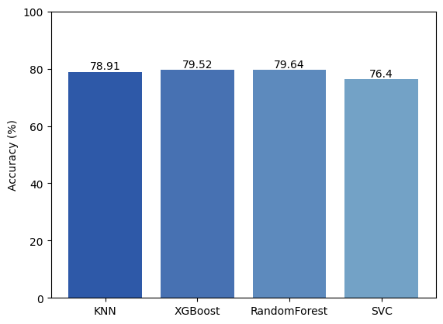
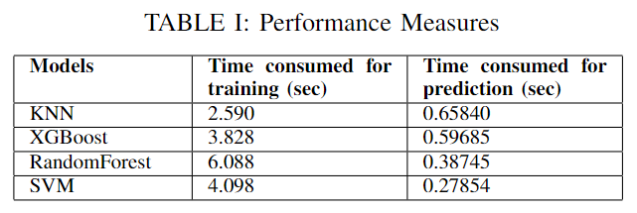
Evaluation
Fig. 4: Accuracy of all the models

Slide 8
Conclusion and Future Works
The goal is to predict unsuccessful tasks in advance and reduce waste.
A failure prediction model can improve performance and lower costs.
A new general model was created using classification algorithms and feature selection methods, achieving high accuracy for Alibaba trace.
To ensure the validity of the findings, it is recommended to further investigate and analyse the data by utilising Google Cloud Trace and other relevant trace datasets.
In addition, the incorporation of novel algorithms and sophisticated methodologies will be undertaken.

Slide 9
References
Chen, X.; Lu, C.D.; Pattabiraman, K. Failure analysis of jobs in compute clouds: A google cluster case study. In Proceedings of the 2014 IEEE 25th International Symposium on Software Reliability Engineering, Naples, Italy, 3–6 November 2014; pp. 167–177.
Reiss, C.; Tumanov, A.; Ganger, G.R.; Katz, R.H.; Kozuch, M.A. Heterogeneity and dynamicity of clouds at scale: Google trace analysis. In Proceedings of the 3rd ACM Symposium on Cloud Computing, San Jose, CA, USA, 14–17 October 2012; p. 7.
Snir, M.; Wisniewski, R.W.; Abraham, J.A.; Adve, S.V.; Bagchi, S.; Balaji, P.; Belak, J.; Bose, P.; Cappello, F.; Carlson, B.; et al. Addressing failures in exascale computing. Int. J. High Perform. Comput. Appl. 2014, 28, 129–173
Jhawar, R.; Piuri, V.; Santambrogio, M. A comprehensive conceptual system-level approach to fault tolerance in cloud computing. In Proceedings of the 2012 IEEE International Systems Conference SysCon 2012, Vancouver, BC, Canada, 19–22 March 2012; pp. 1–5

Slide 10
Thank you

